Slide 1
Regression
Basic Statistical
Assumption

Slide 2
Why do we care about assumption
In Regression if assumptions are not passed then
1. Regression coefficients
2. Standard Errors
3. Cofidence Interval
4. Significance test
Biased

Slide 3
While the assumption of a linear model are never perfectly met,
We must still check if they are statistical significance to work with

Slide 4
Assumptions are:-
0. Include all necessary features.
1. All Xs are conceptualy related to Ys
2. Linearity, additive and numeric.
3. Reliability of each of our measure is 1.0
4. All X’s must be independent.

Slide 5
Assumptions are:-
5. Any DV should be independent
6. Residual Assumptions
→ Independent
→ Normally distributed
→ Constant Variance (Homoscedasticity of residuals )
→ Mean is Zero
→ Residuals and X variables must be uncorrelated
7. No Multicollinearity
8. Records must greater than predictors
9. Variability in predictors or X values are positive

Slide 6
1. Include all necessary Features
On the basis of :-
1. Domain Expert
2. Logical Relationship (Intitutive) in absence of Domain Expert

Slide 7
1. Include all necessary Features- Hands On
Use case:-
Predict Weight when Age given
Age will affect the weight of a person, more aged person likely to gain more weight or start to store fats in body (Even Medical theroy support this)

Slide 8
2. Linearity, additive and Numeric
What-
All multivariate techniques are based on correlation measures of association
-> Where is the kingdom of correlation
1. Multiple Regression
2. Logistic Regression
3. Factor Analysis
4. Structural equation modeling
-> Correlation represent only Linear association b/w variables
Nonlinear effect will not be represented in correlation value
Violation of linearity or additivity :-
-> Extremely serious
-> When linear model fit especially beyond the range of sample data

Slide 9
2. Linearity, additive and Numeric
What-
Additive – The contributions of different IV to DV are additive
Exa- Addative means that IV have direct only impact on DV
sales = 100cr + 10*Advertisment + 15*No of sales force
If any of the IV becomes 0 then sales do not become 0
But if sales = 100cr * 10*Advertisment * 15*No of sales force
So if nay of the variable become 0 then sales become 0

Slide 10
2. Linearity, additive and Numeric
How to diagnose
->If the parameters are non-numeric like categorical then use one-hot encoding (python) or dummy encoding (R) to convert them to numeric.
-> Most common way
-> Scatterplots of variables
-> Run regression analysis and examine the residuals
-> plot of observed versus predicted values (points should be symmetrically distributed around a diagonal line)
->residuals versus predicted values (points should be symmetrically distributed around horizontal line)
Note:- Residual-versus-predicted-plot is better than observed-versus-predicted , because it eliminates the visual distraction of a sloping pattern.
-> Look carefully for evidence of a "bowed" pattern, indicating that the model makes systematic errors whenever it is making unusually large or small predictions.

Slide 11
2. Linearity, additive and Numeric
How to fix:
→ Most direct approach transform one or both variables to achieve linearity.
→ Adding another regressor that is a nonlinear function of one of the other variables

Slide 12
2. Linearity, additive and Numeric
How to fix:
→ Use dummies
Y=a+bX+e becomes
Y=a+b₁D₁+ …+b_{k-1}D_{k-1}+e where X is broken up into k dummies (D_{i}) and k-1 is included. If the R-square of this equation is significantly higher than the R-square of the original that is a sign of non-linearity. The pattern of the slopes (b_{i}) will indicate the shape of the non-linearity.

Slide 13
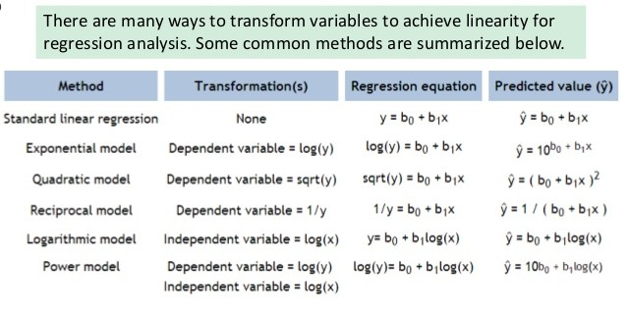
2. Linearity, additive and Numeric
How to fix:

Slide 14
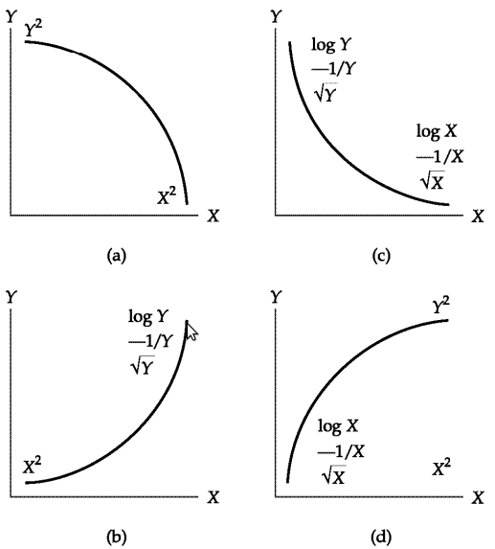
2. Linearity, additive and Numeric
How to fix:
Variables are on scatter plot.
Note: For multiple transformation, start with top method(shown on graph) and
move downward until
linearity is achieved.

Slide 15
Linearity Hands on

Slide 16
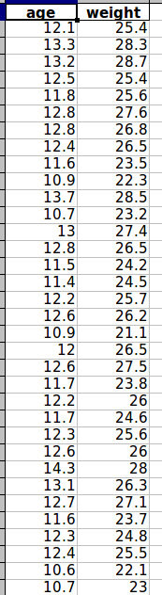
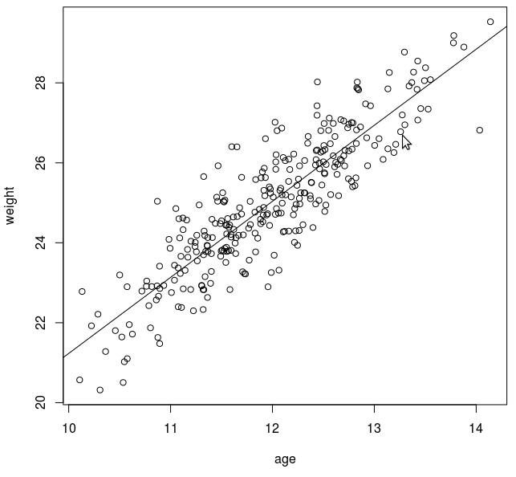
Linearity Hands on
Use Case Age vs Weight
Satter Plot

Slide 17
Linearity Hands on
→ Age and weight have strong positive linear relationship as interpreted from scatter plot, If age increases then weight also increase in same fashion.

Slide 18
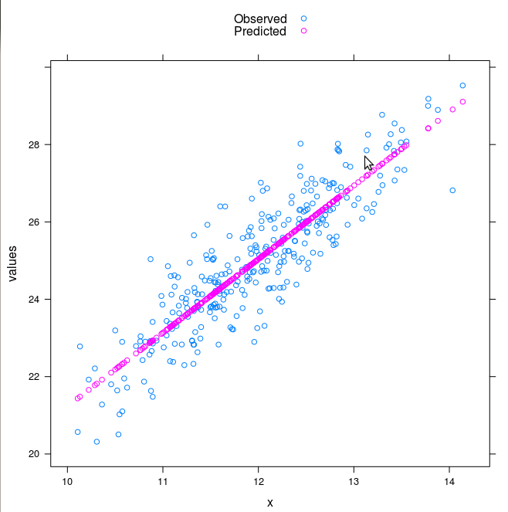
Linearity Hands on
Observed vs Predicted,

Slide 19
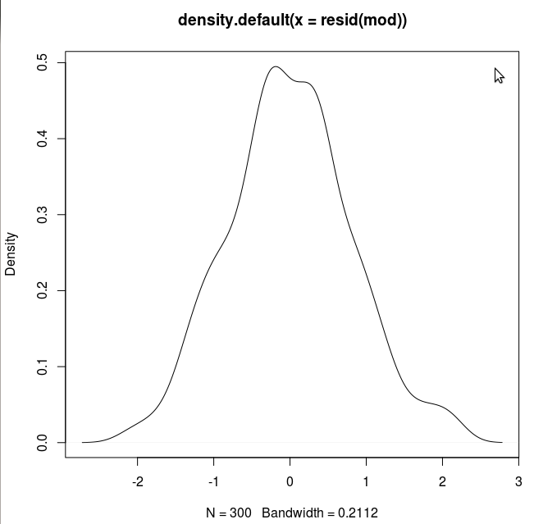
Linearity Hands on
Residuals and its plot
Residuals are normally distributed

Slide 20
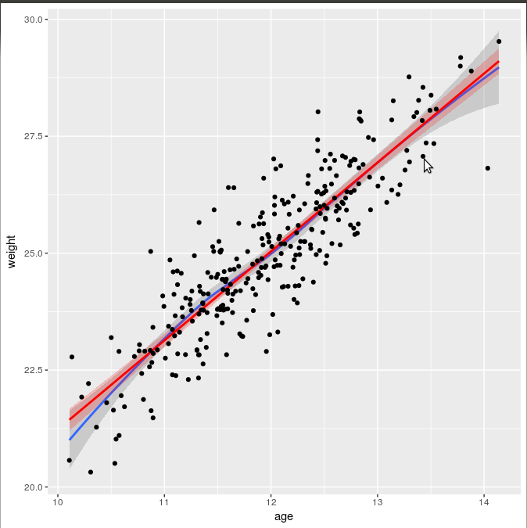
Linearity Hands on
In this plots, the grey shading corresponds to the standard errors for the loess smoother fit, while the red shading corresponds to the standard errors for the linear fit.
The blue line is a loess smoothed line and the red line is a linear regression line.
As long as the loess smoother roughly approximates the linear line, the assumption of linearity has been met.
It appears that the relationships between X’s and Y’s are roughly linear.

Slide 21
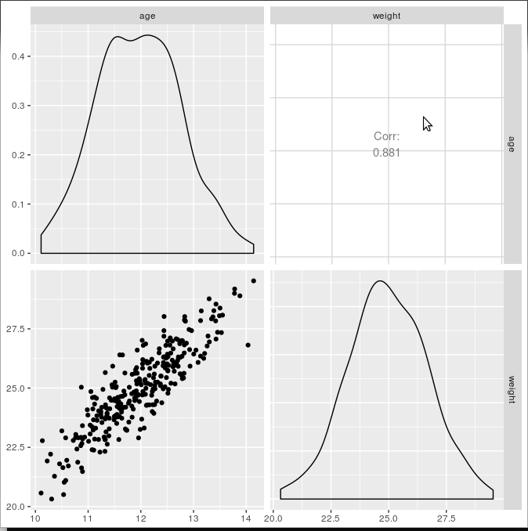
Linearity Hands on
Pair plot
Corelation between age and weight is 0.88
It shows strong positive corelation between age and weight
Age data is bimodal distribution
Weight data is normal distribution

Slide 22
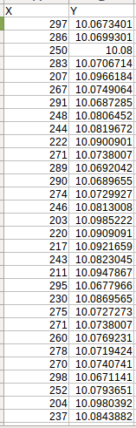
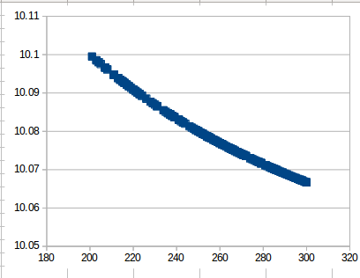
Linearity Hands on
Inverse Realationship How to find residuals and plot them
Y = a+b/X+e
Satter Plot

Slide 23
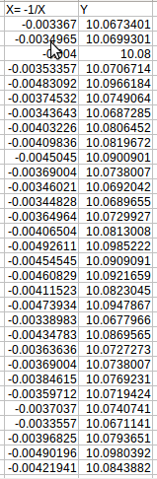
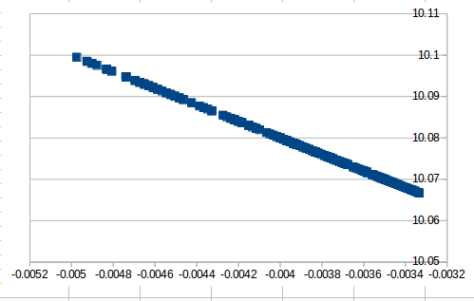
Linearity Hands on
Transform X
X_new = -1/x
Satter Plot

Slide 24
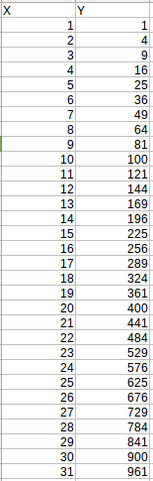
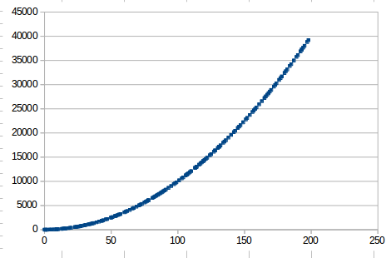
Linearity Hands on
Exponential Realationship
Y = a+bX*X+e
Satter Plot

Slide 25
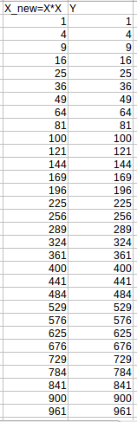
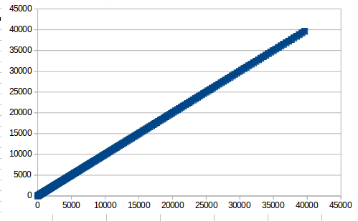
Linearity Hands on
Exponential Realationship
X_new = X*X
Satter Plot

Slide 26
3. Reliability of each of our measure is 1.0
This assumption is almost always violated, particularly in psychology and other fields that generate their own scales, including measures of self-report. Typically, a reasonable cutoff is considered a reliabilty of .7.
This will typically downward bias (make smaller) the regression coefficients in your model. This will not be covered in this tutorial as meeting this assumption is nearly impossible and reliability/psychometrics stand on their own as an entire topic of statistical study.

Slide 27
4. All X’s must be independent.
→The independence assumption means that two variables will not necessarily influence one another.
→ The most common violation of this occurs with data that are collected over time or time series analysis.
Example:- 1. High tariff rates in one period are often associated with very high tariff rates in the next period
2. Adervist

Slide 28
5. Consecutive DV’s should be independent
Knowledge of study design or data collection in order to determine the validity of assumption

Slide 29
6. Residual Assumptions
→ Independent
→ Normally distributed
→ Constant Variance (Homoscedasticity of residuals )
→ Mean is Zero
→ Residuals and X variables must be uncorrelated

Slide 30
6. Residual Assumptions:-
Independent
What
Independent - Statistical independence of the errors (in particular, no correlation between consecutive errors in the case of time series data)
Violations of independence
→ Potentially very serious in time series regression models
→ Serial correlation in the errors (i.e., correlation between consecutive errors or errors separated by some other number of periods) means that there is room for improvement in the model
→ Serial correlation (autocorrelation) is sometimes a byproduct of a violation of the linearity assumption
→ Independence can also be violated in non-time-series models if errors tend to always have the same sign under particular conditions I.e if the model systematically under predicts or over predicts what will happen when the independent variables have a particular configuration.

Slide 31
6. Residual Assumptions:-
Independent
How to diagnose:
→ Residual time series plot
→ Table or plot of residual autocorrelations
→ For non-time-series violations of independence.
1 Plots of the residuals versus independent variables
2. Plots of residuals versus row number in situations where the rows have been sorted or grouped in some way that depends (only) on the values of the independent variables.
What to observed:-
→ Residuals should be randomly and symmetrically distributed around zero under all conditions, and in particular there should be no correlation between consecutive errors no matter how the rows are sorted
→ If this is not true, it could be due to a violation of the linearity assumption or due to bias that is explainable by omitted variables (say, interaction terms or dummies for identifiable conditions).

Slide 32
6. Residual Assumptions:-
Independent
How to fix:
→ Minor cases of positive serial correlation (lag-1 residual autocorrelation in the range 0.2 to 0.4 or Durbin-Watson statistic between 1.2 and 1.6)
→ There is some room for fine-tuning in the model. Consider adding lags of the dependent variable and/or lags of some of the independent variables.

Slide 33
6. Residual Assumptions:-
Normally distributed
No model is perfect. We expect errors—but we want the errors (residuals) to be reasonably normal.

Slide 34
6. Residual Assumptions:-
Normally distributed
What:-
→ Normality is most fundamental assumption in multivariate
→ The assumption of normality in regression manifests in three ways:
1. For confidence intervals around a parameter to be accurate, the parameter must come from a normal distribution.
2. For significance tests of models to be accurate, the sampling distribution of the thing we’re testing must be normal.
3. To get the best estimates of parameters (i.e., betas in a regression equation), the residuals in the population must be normally distributed.

Slide 35
6. Residual Assumptions:-
Normally distributed
Violation:-
→ If variation from normal distribution is sufficient large, all statistical test(F & t ) are invalid
→ Non-Normality is based on two dimension
1. Shape of offending distribution
→ Impact due to the shape of the Distribution.
→ Shape of distribution describe by:-
1. Kurtosis(Peakedness, Flatness)
2. Skewness (imbalance of the distribution I.e Left Skewed or Right Skewed)
2. Sample Size
→ Impact due to Sample size:-
Sample size has the effect of increasing statistical power by reduce sample error

Slide 36
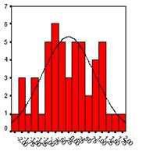
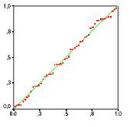
6. Residual Assumptions:-
Normally distributed
How to diagnose:-
→ We can test the normality of data in two ways- 1. Graphical Analysis 2.Statistical Test
1. Graphical Analysis
→ Histogram:– Simplest diagnostic test for normality
→ Q-Q-Plot
Q-Q-Plot
Histogram

Slide 37
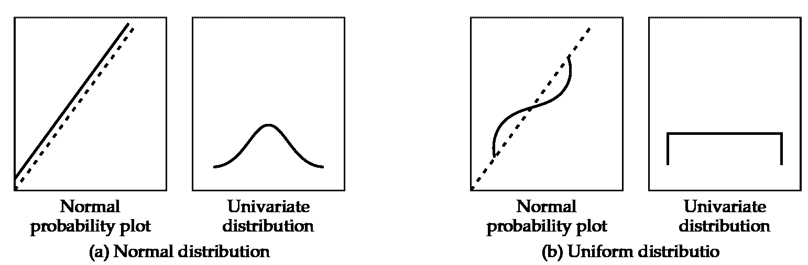
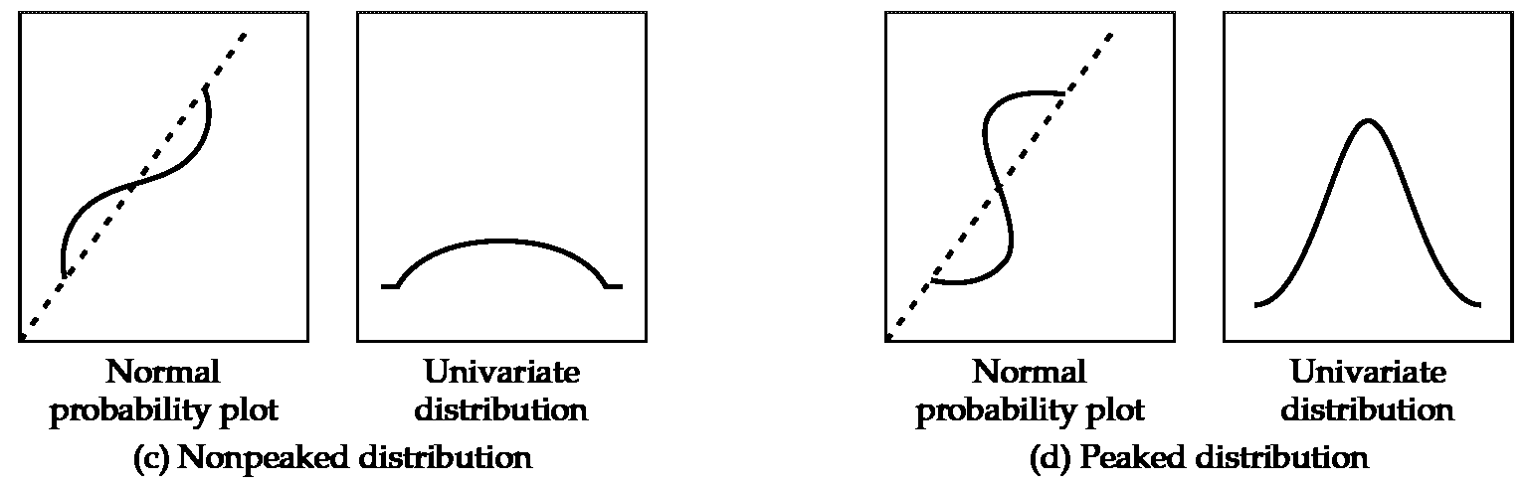
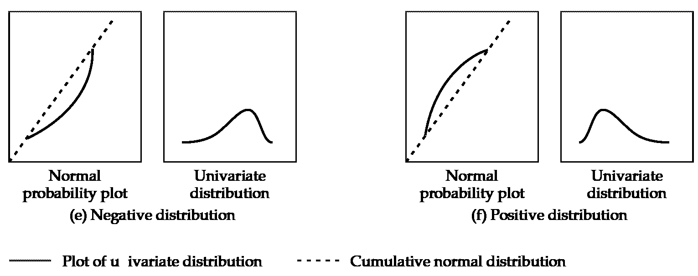
6. Residual Assumptions:-
Normally distributed
How to diagnose:-
→ Normal Probability plot:- Compare the cumulative distribution of actual data values with the cumulative distribution of normal distribution

Slide 38
6. Residual Assumptions:-
Normally distributed
How to diagnose:-
2. Statistical Test
→ z value
→ z value is calculated either by Skewness or Kurtosis.
→ Distribution is non normal if calculated z value exceed specified critical value.
→ Most commonly used critical values are
(0.01 significance level)
(0.05 error level)
→ Other statistical test for normality.
→ Shapiro-wilks test
→ Kolmogorov-Smirnov test, Anderson–Darling test
Note:- Due to sample size both the graphical plot & any statistical test to assess the actual degree of departure from normality

Slide 39
6. Residual Assumptions:-
Normally distributed
Note:- Other assumptions are violated due to non-normality. So fixing normality first may assist in meeting other statistical assumption as well
How to fix:-
→ Violations of normality often arise either because
(a) The distributions of the dependent and/or independent variables are themselves significantly non-normal, and/or
(b) The linearity assumption is violated.
(c) Presence of outliers
Nonlinear transformation of variables might cure (a) & (c) problems.

Slide 40
6. Residual Assumptions:-
Normally distributed
How to diagnose:
→ The best test for normally distributed errors is a normal probability plot or normal quantile plot of the residuals.
→ This is a plot of the fractiles of error distribution versus the fractiles of a normal distribution having the same mean and variance. If the distribution is normal, the point on this plot should fall close to the diagonal line
→ A bow-shaped pattern of deviations from the diagonal indicates that the residuals have excessive skewness (i.e., they are not symmetrically distributed, with too many large errors in one direction)
→ An S-shaped pattern of deviations indicates that the residuals have excessive kurtosis--i.e., there are either too many or two few large errors in both directions.

Slide 41
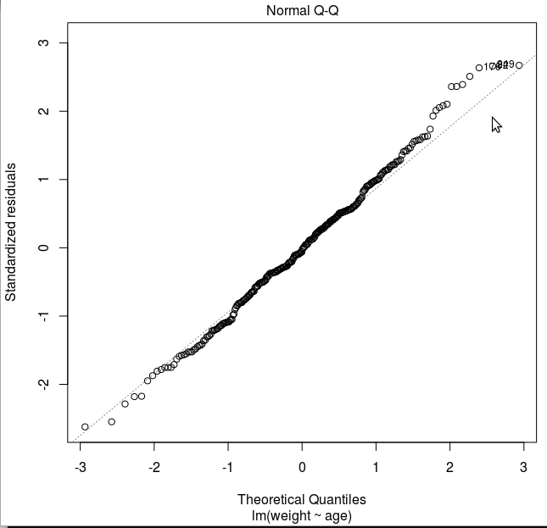
Normally distributed Hands on
Mostof the observation roughly falls on the straight line, indicating that our residuals are roughly normally distributed.

Slide 42
6. Residual Assumptions:-
Constant Variance (Homoscedasticity of residuals )

Slide 43
6. Residual Assumptions:-
Constant Variance (Homoscedasticity of residuals )
What:
→ Homogeneity of variance occurs when the spread of scores for your criterion is the same at each level of the predictor.
→ Homoscedasiticity refers to the assumption that DV(s) exhibit equal levels of variance across the range of IV(s).

Slide 44
6. Residual Assumptions:-
Constant Variance (Homoscedasticity of residuals )
Why:
→ When this assumption is satisfied, parameter estimates will be optimal.
→ Variance of DV explained dependence relationship should not be concentrated in only a limited range of the independent values.
Exa: Many different values of the DV at each of the IV. So to fully captured the relationship, the dispersion(variance) of the DV values must be relatively equal at each value of the IV.

Slide 45
6. Residual Assumptions:-
Constant Variance (Homoscedasticity of residuals )
Most common source:
→ Variable type:- Many types of variable have a natural tendency towards differences in dispersion
→ Skewed distribution of one or both variable
Violation:
→ Predictions to be better at some levels of IV than at other.
→ In consistency in Standard errors & parameter estimates
→ Make hypothesis test either too stringent or too insensitive

Slide 46
6. Residual Assumptions:-
Constant Variance (Homoscedasticity of residuals )
How to diagnose:
1. Graphical Test
2. Statistical Test

Slide 47
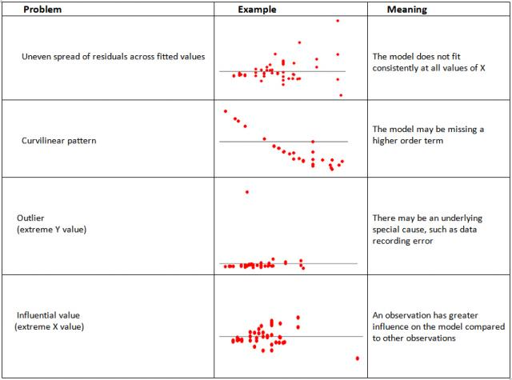
6. Residual Assumptions:-
Constant Variance (Homoscedasticity of residuals )
How to diagnose:

Slide 48
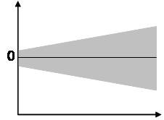
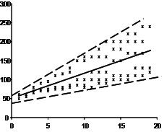
6. Residual Assumptions:-
Constant Variance (Homoscedasticity of residuals )
1. Graphical Test:
A. For Metric Variables
→ Scatter Plot: Scatter plot shows different types shape like, Cone(small dispersion at one side of the graph, large dispersion at opposite side) and Diamonds(a large number of points at the center of the distribution)
B. For Categorical Variables
→ Boxplots: Lenght of the Box and Whisker portray the variation of the data within the group

Slide 49
6. Residual Assumptions:-
Constant Variance (Homoscedasticity of residuals )
2. Statistical Test:
A. Levence test
B. Goldfeld-Quandt test
C. Box’s M test
A. Levence test
→It is use to see whether the variance of a single metric variable are equal across any number of groups

Slide 50
6. Residual Assumptions:-
Constant Variance (Homoscedasticity of residuals )
B. Goldfeld-Quandt test(two-group test)
→ It compares variances of two subgroups; one set of high values and one set of low values. If the variances differ, the test rejects the null hypothesis that the variances of the errors are not constant.
→ The assumption for the test is that the data is normally distributed
How to fix Heteroscedastic
→It is fix through data transformation.
→Similar to those used to achieve normality

Slide 51
Homoscedasticity Hands on

Slide 52
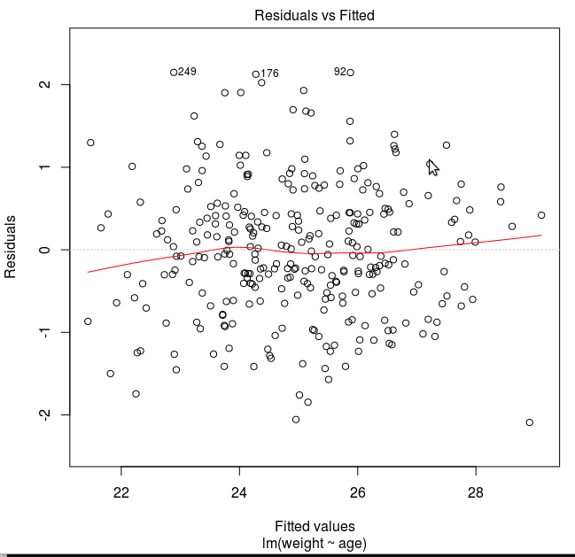
Homoscedasticity Hands on
Plot shows that the fitted values along x increase, the residuals increase and become constant then again increase. This pattern is indicated by the red line, which should be approximately flat if the disturbances are homoscedastic.

Slide 53
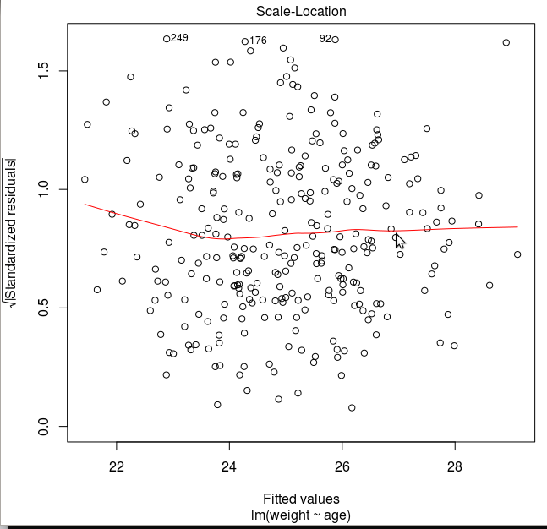
Homoscedasticity Hands on
Plot shows that the fitted values along x increase, the residuals decrease and become constant . This pattern is indicated by the red line, which should be approximately flat if the disturbances are homoscedastic.

Slide 54
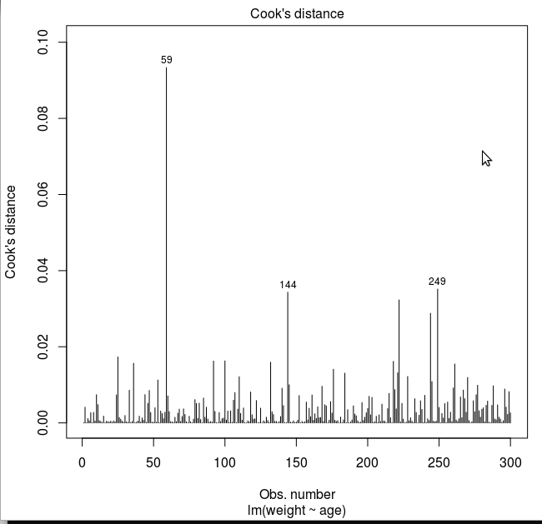
Homoscedasticity Hands on

Slide 55
6. Residual Assumptions:-
Mean is Zero
Check the mean of the residuals. If it zero (or very close), then this assumption is held true for that model. This is default unless you explicitly make amends, such as setting the intercept term to zero.
How to check
> model <- lm(formula = DV ~ IV, data= DataFrame)
> mean(model$residuals)
> mean(mod$residuals)
[1] -1.461143e-18

Slide 56
6. Residual Assumptions:-
Residuals and X variables must be uncorrelated
How to diagnose:
→ Do correlation test between IV and Residuals
→ If p value is greater than zero, so the null hypothesis that the true correlation is Zero cannot be rejected. So the assumption holds true for model.

Slide 57
6. Residual Assumptions:-
Residuals and X variables must be uncorrelated
Hands on
Pearson's product-moment correlation
data: weight and mod$residuals
t = 9.2878, df = 298, p-value < 2.2e-16
alternative hypothesis: true correlation is not equal to 0
95 percent confidence interval:
0.3810043 0.5571504
sample estimates:
cor
0.4738028
p-value is so low, so null hypothesis that true correlation is 0 rejected. So, the assumption not holds true for this model.

Slide 58
9. No Multicollinearity
What:
Multicollinearity occurs when the independent variables are too highly correlated with each other.
How to diagnose
1) Correlation matrix – when computing the matrix of Pearson’s Bivariate Correlation among all independent variables the correlation coefficients need to be smaller than 1.
2) Tolerance - the tolerance measures the influence of one independent variable on all other independent variables; the tolerance is calculated with an initial linear regression analysis. Tolerance is defined as
T = 1 – R² for these first step regression analysis. With T < 0.1 there might be multicollinearity in the data and with T < 0.01 there certainly is.
3) Variance Inflation Factor (VIF) – the variance inflation factor of the linear regression is defined as VIF = 1/T. With VIF > 10 there is an indication that multicollinearity may be present; with VIF >100 there is certainly multicollinearity among the variables.

Slide 59
9. No Multicollinearity
How to fix
If multicollinearity is found in the data, centering the data (that is deducting the mean of the variable from each score) might help to solve the problem.
2) Either iteratively remove the X var with the highest VIF
3) See correlation between all variables and keep only one of all highly correlated pairs.

Slide 60
10. Observation must greater than predictors
This can be directly observed by looking at the data.

Slide 61
11. Variability in predictors or X values are positive
This means the X values in a given sample must not all be the same (or even nearly the same).

Slide 62
Thank You!

